Slide 1
Undersmoothed HAL-based plugin estimator for direct/indirect effects
Develop and test undersmoothed HAL-based plugin estimator for direct/indirect effects, or other more complex parameters.
Seraphina

Slide 2
Undersmoothing
Getting the initial lambda
from a HAL fit with smoothness_orders = 0
Getting the undersmoothed lambda:
Generate a panel of lambdas
initial lambda * seq(from=0, to=-3, length=20)
Pick the first lambda that satisfies the criteria:
Max score <= 1/(sqrt(n) * log(n))

Slide 3


Controlled direct effects
Data structure:
W: baseline, continuous
A: treatment dosage, continuous, bounded
Z: intermediate curve, binary
Y: outcome, binary
Causal target parameter:
Dose response curve

Slide 4
Controlled direct effects - simulations
Generate data with given sample size n with the given DGD
Fitting the Y ~ X directly with undersmoothed HAL using the sample once
max_degree = 3
smoothness_orders = 1
base_num_knots_0 = 20
base_num_knots_1 = 20
Estimating the targeted parameter by calculating the simple substitution estimator
Predicting given a and z
using the fitted undersmoothed HAL for all combinations of a and z

Slide 5
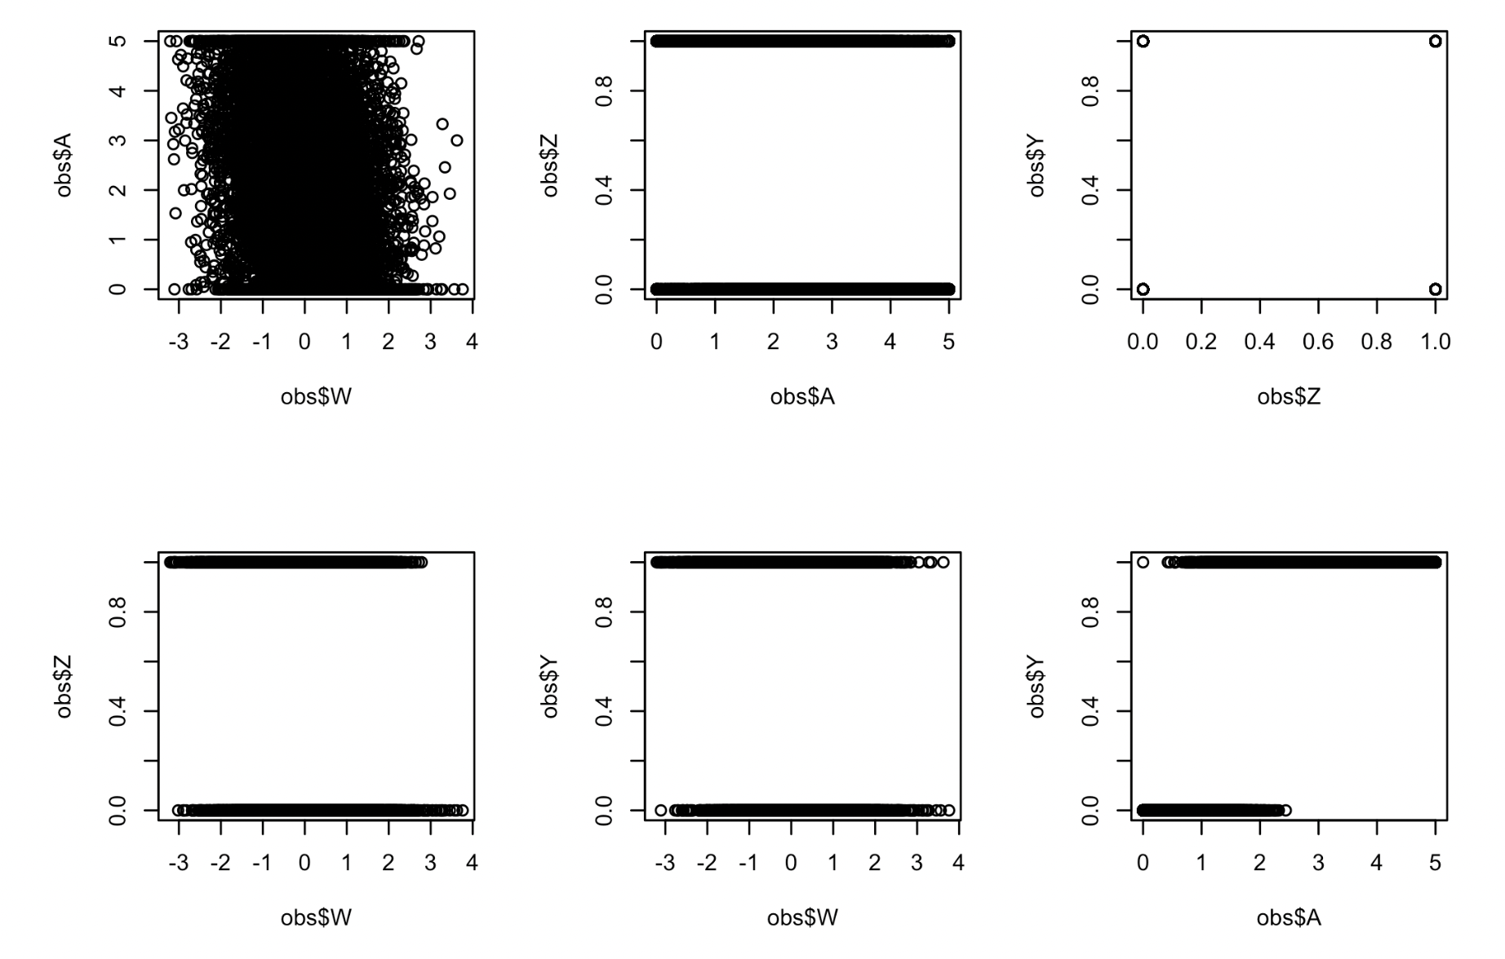
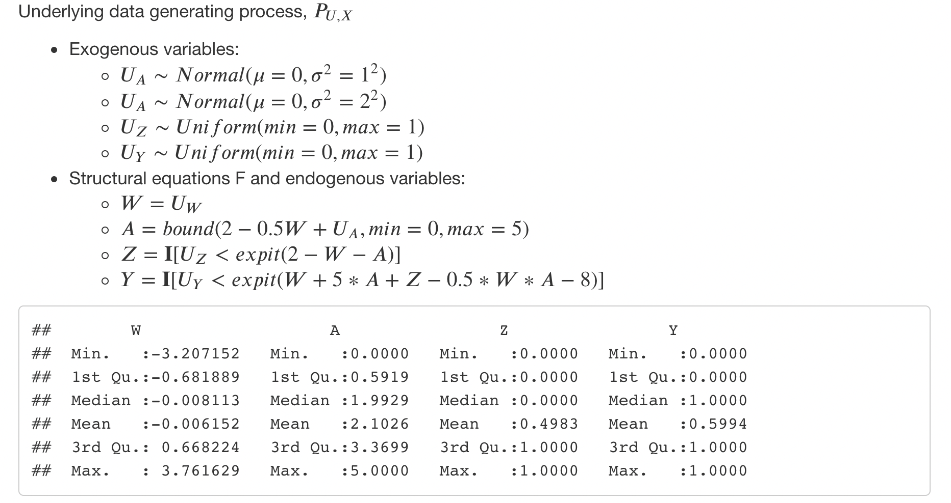
Simulation #1

Slide 6
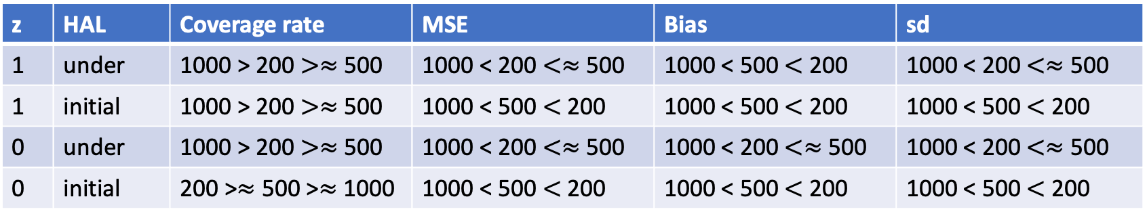
Simulation #1 – Results summary
n | z | Coverage rate | MSE | Bias | sd
200 | 1 | Under > Initial | Initial < Under | Initial < Under | Initial < Under
200 | 0 | Under > Initial | Initial < Under | Initial < Under | Initial < Under
500 | 1 | Under > Initial | Initial < Under | Initial < Under | Initial < Under
500 | 0 | Under > Initial | Initial < Under | Initial < Under | Initial < Under
1000 | 1 | Under > Initial | Initial < Under | Initial < Under | Initial < Under
1000 | 0 | Under > Initial | Initial < Under | Initial < Under | Initial < Under
Compare between sample sizes:
z | HAL | Coverage rate | MSE | Bias | sd
1 | under | 1000 > 200 $>≈$ 500 | 1000 < 200 $<≈$ 500 | 1000 < 500 $<$ 200 | 1000 < 200 $<≈$ 500
1 | initial | 1000 > 200 $>≈$ 500 | 1000 < 500 $<$ 200 | 1000 < 500 $<$ 200 | 1000 < 500 $<$ 200
0 | under | 1000 > 200 $>≈$ 500 | 1000 < 200 $<≈$ 500 | 1000 < 200 $<≈$ 500 | 1000 < 200 $<≈$ 500
0 | initial | 200 >$≈$ 500 >$≈$ 1000 | 1000 < 500 $<$ 200 | 1000 < 500 $<$ 200 | 1000 < 500 $<$ 200
Estimations performed better when z = 1 almost for all a’s

Slide 7
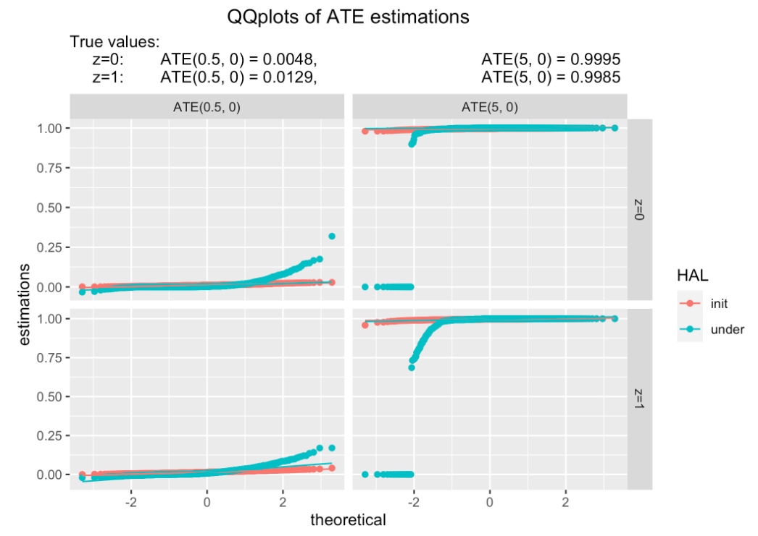
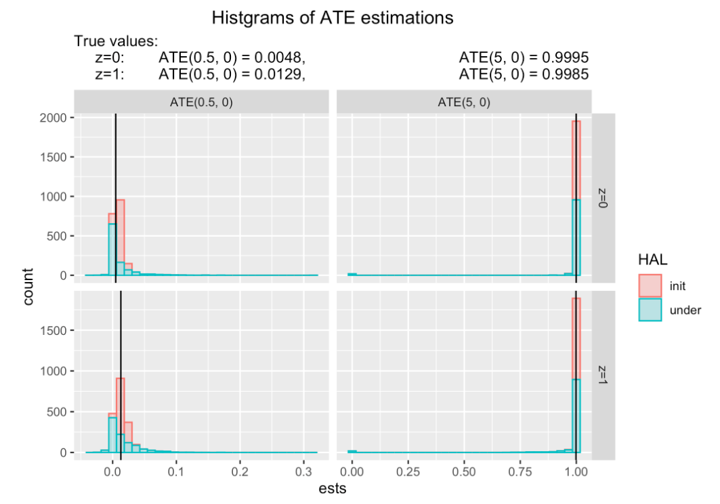
Prediction distribution visualizations
n = 1000, B = 1000
Notes:
N = 200, try n = 1000
N -> 2000
Asymtopically non-linear?
Sampling distributions + qq plot
Undersmooth too Much?
Different way to undersmooth?
-> more empirical? Not max, but plate
->

Slide 8
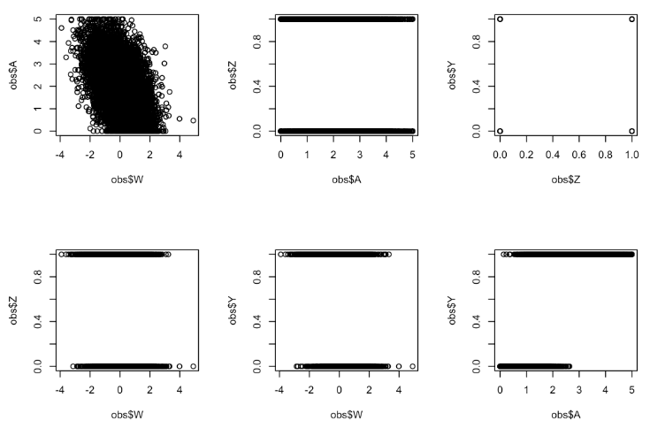
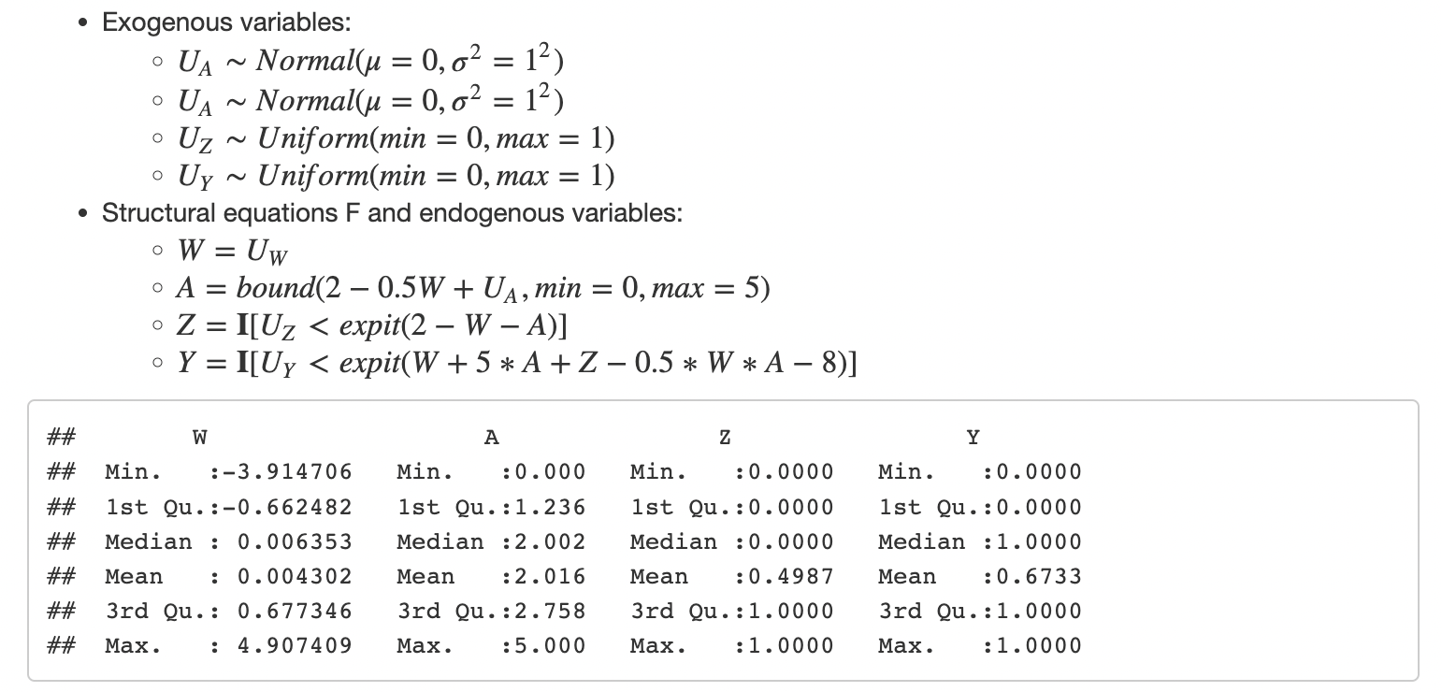
Simulation #1-1

Slide 9
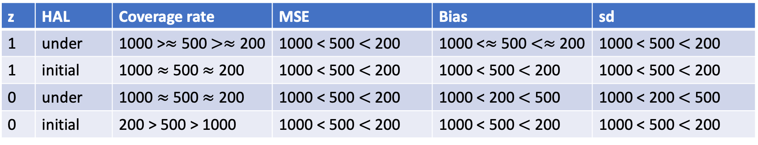
Simulation #1-1 – Results summary
n | z | Coverage rate | MSE | Bias | sd
200 | 1 | Under > Initial | Initial < Under | Initial < Under | Initial < Under
200 | 0 | Under > Initial | Initial < Under | Initial < Under | Initial < Under
500 | 1 | Under > Initial | Initial < Under | Initial < Under | Initial < Under
500 | 0 | Under > Initial | Initial < Under | Initial < Under | Initial < Under
1000 | 1 | Under > Initial | Initial < Under | Initial < Under | Initial < Under
1000 | 0 | Under > Initial | Initial < Under | Initial < Under | Initial < Under
z | HAL | Coverage rate | MSE | Bias | sd
1 | under | 1000 >$≈$ 500 $>≈$ 200 | 1000 < 500 $<$ 200 | 1000 <$≈$ 500 $<≈$ 200 | 1000 < 500 $<$ 200
1 | initial | 1000 $≈$ 500 $≈$ 200 | 1000 < 500 $<$ 200 | 1000 < 500 $<$ 200 | 1000 < 500 $<$ 200
0 | under | 1000 $≈$ 500 $≈$ 200 | 1000 < 500 $<$ 200 | 1000 < 200 $<$ 500 | 1000 < 200 $<$ 500
0 | initial | 200 > 500 > 1000 | 1000 < 500 $<$ 200 | 1000 < 500 $<$ 200 | 1000 < 500 $<$ 200
Estimations performed better when z = 1 almost for all a’s

Slide 10

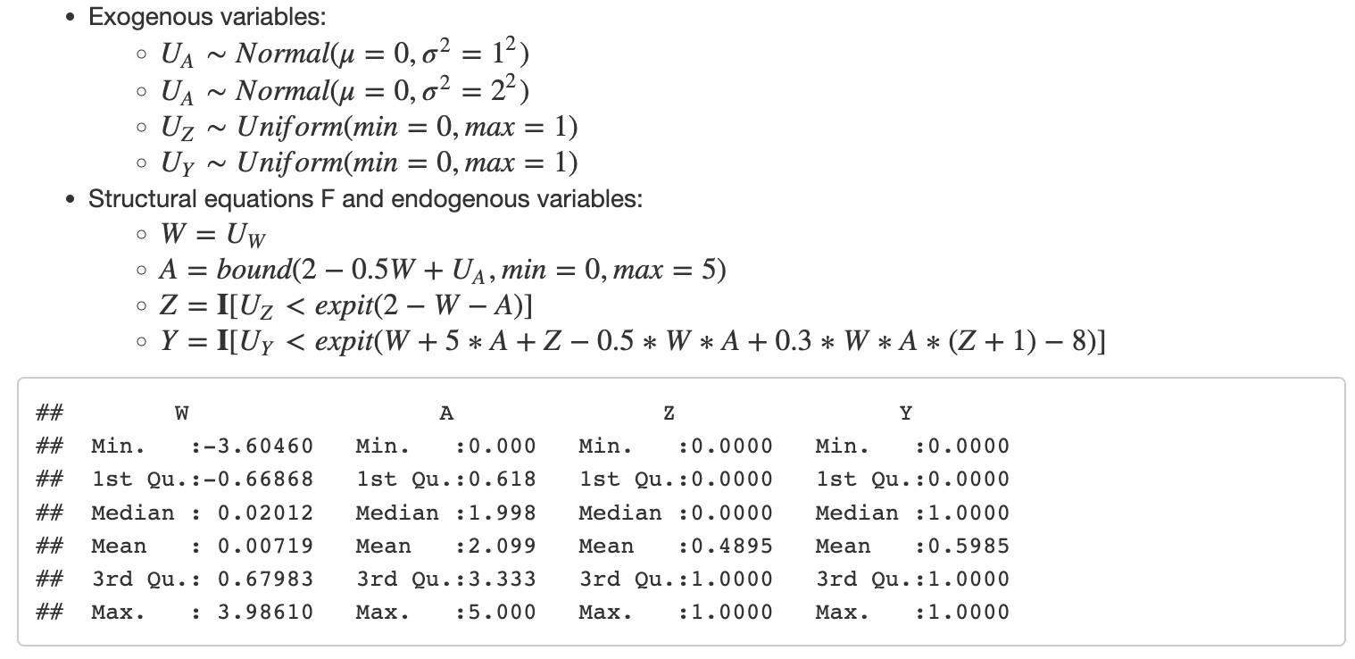
Simulation #1-2

Slide 11
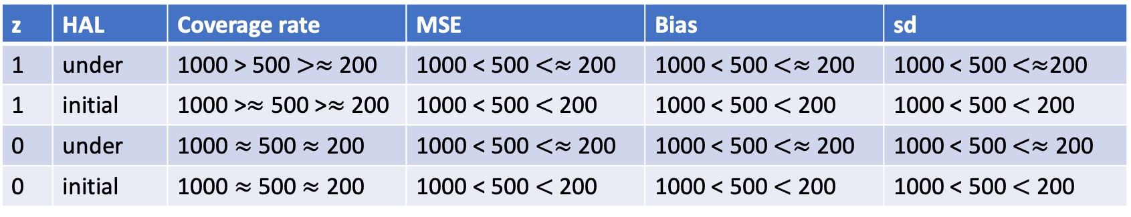
Simulation #1-2 – Results summary
n | z | Coverage rate | MSE | Bias | sd
200 | 1 | Under > Initial | Initial < Under | Initial < Under | Initial < Under
200 | 0 | Under > Initial | Initial < Under | Initial < Under | Initial < Under
500 | 1 | Under > Initial | Initial < Under | Initial < Under | Initial < Under
500 | 0 | Under > Initial | Initial < Under | Initial < Under | Initial < Under
1000 | 1 | Under > Initial | Initial < Under | Initial < Under | Initial < Under
1000 | 0 | Under > Initial | Initial < Under | Initial < Under | Initial < Under
z | HAL | Coverage rate | MSE | Bias | sd
1 | under | 1000 > 500 $>≈$ 200 | 1000 < 500 $<≈$ 200 | 1000 < 500 $<≈$ 200 | 1000 < 500 $<≈$200
1 | initial | 1000 >$≈$ 500 >$≈$ 200 | 1000 < 500 $<$ 200 | 1000 < 500 $<$ 200 | 1000 < 500 $<$ 200
0 | under | 1000 $≈$ 500 $≈$ 200 | 1000 < 500 $<≈$ 200 | 1000 < 500 $<≈$ 200 | 1000 < 500 $<≈$ 200
0 | initial | 1000 $≈$ 500 $≈$ 200 | 1000 < 500 $<$ 200 | 1000 < 500 $<$ 200 | 1000 < 500 $<$ 200
Estimations performed better when z = 1 almost for all a’s

Slide 12
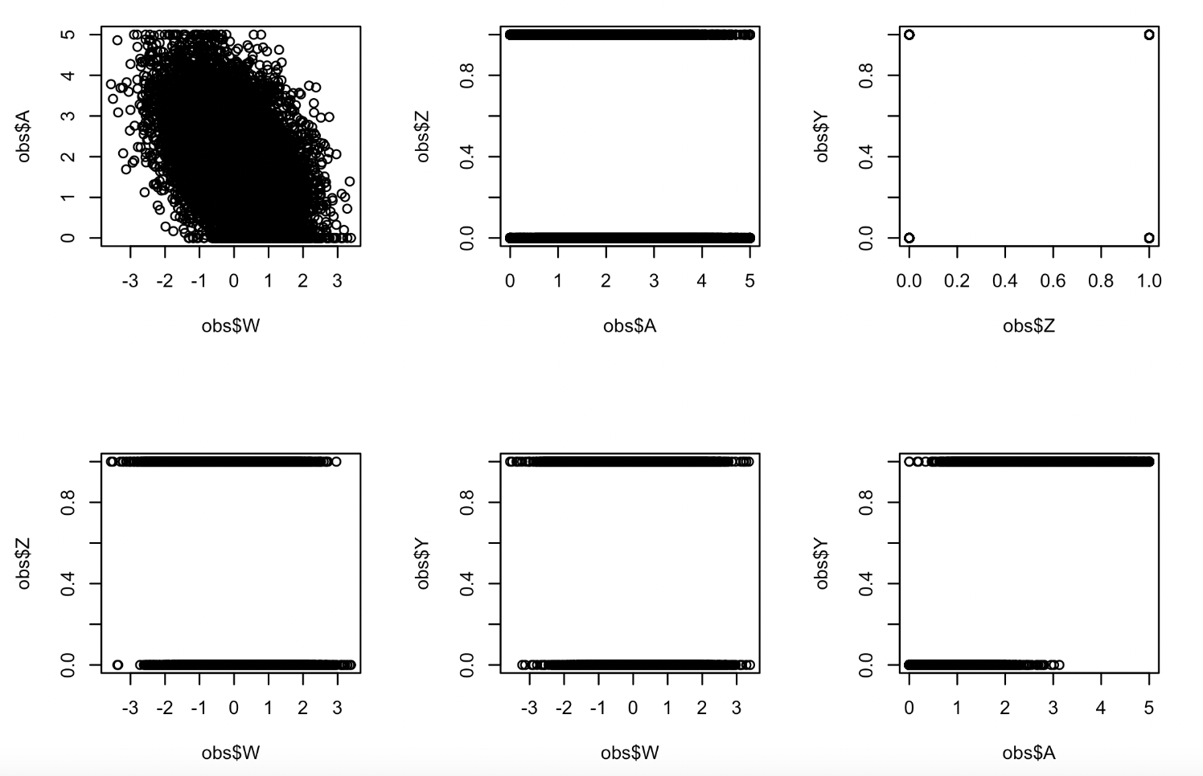
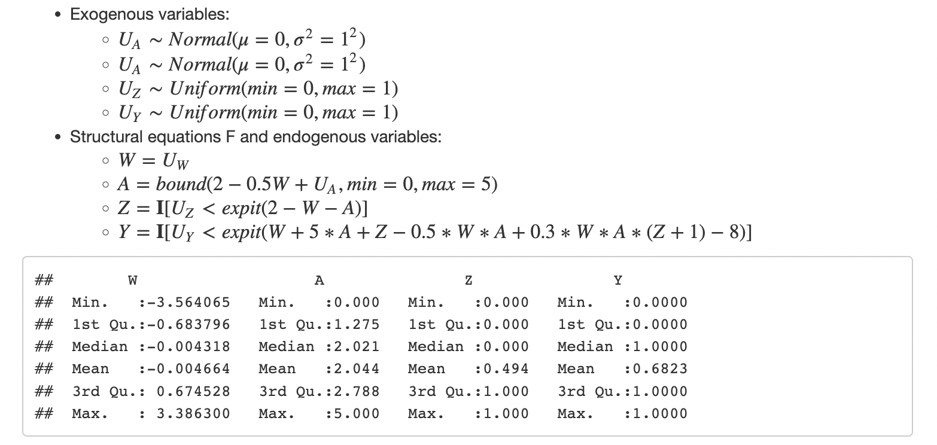
Simulation #1-3

Slide 13
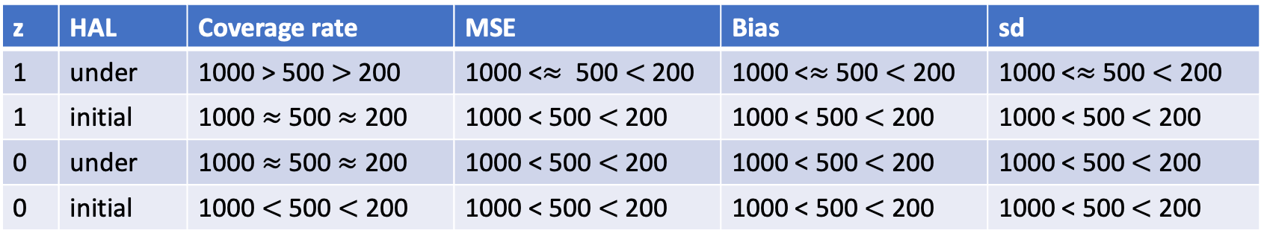
Simulation #1-3 – Results summary
n | z | Coverage rate | MSE | Bias | sd
200 | 1 | Under > Initial | Initial < Under | Initial < Under | Initial < Under
200 | 0 | Under > Initial | Initial < Under | Initial < Under | Initial < Under
500 | 1 | Under > Initial | Initial < Under | Initial < Under | Initial < Under
500 | 0 | Under > Initial | Initial < Under | Initial < Under | Initial < Under
1000 | 1 | Under > Initial | Initial < Under | Initial < Under | Initial < Under
1000 | 0 | Under > Initial | Initial < Under | Initial < Under | Initial < Under
z | HAL | Coverage rate | MSE | Bias | sd
1 | under | 1000 > 500 $>$ 200 | 1000 <$≈$ 500 $<$200 | 1000 <$≈$ 500 $<$ 200 | 1000 <$≈$ 500 $<$ 200
1 | initial | 1000 $≈$ 500 $≈$ 200 | 1000 < 500 $<$ 200 | 1000 < 500 $<$ 200 | 1000 < 500 $<$ 200
0 | under | 1000 $≈$ 500 $≈$ 200 | 1000 < 500 $<$ 200 | 1000 < 500 $<$ 200 | 1000 < 500 $<$ 200
0 | initial | 1000 $<$ 500 $<$ 200 | 1000 < 500 $<$ 200 | 1000 < 500 $<$ 200 | 1000 < 500 $<$ 200
Estimations performed better when z = 1 almost for all a’s

Slide 14
Simulation #1: compare v0, v1, v2, and v3
v0
v1
v2
v3
Positivity violation
3-way interactions
Positivity violation
3-way interactions
N = 1000:
HAL | z | Coverage rate | MSE | Bias | sd
Under | 1 | similar | v1, v3 < v0, v2 | v1, v3 < v0, v2 | v1, v3 < v0, v2
Initial | 1 | v0 > v2 > v1, v3 | v0 < v2 < v3 < v1 | v0, v2 < v1, v3 | v0, v2 < v1, v3
Under | 0 | v0 > v2 > v3 > v1 | v1 < v3 < v2 < v0 | v1, v3 < v0, v2 | v1 < v3 < v2 < v0
Initial | 0 | similar | v0 < v2 < v3 < v1 | v2 < v0 < v1 < v3 | v0, v2 < v1, v3
Notes:
QQ plot of the initial vs undersmoothed pick one value one simulation where estimation do poorly

Slide 15
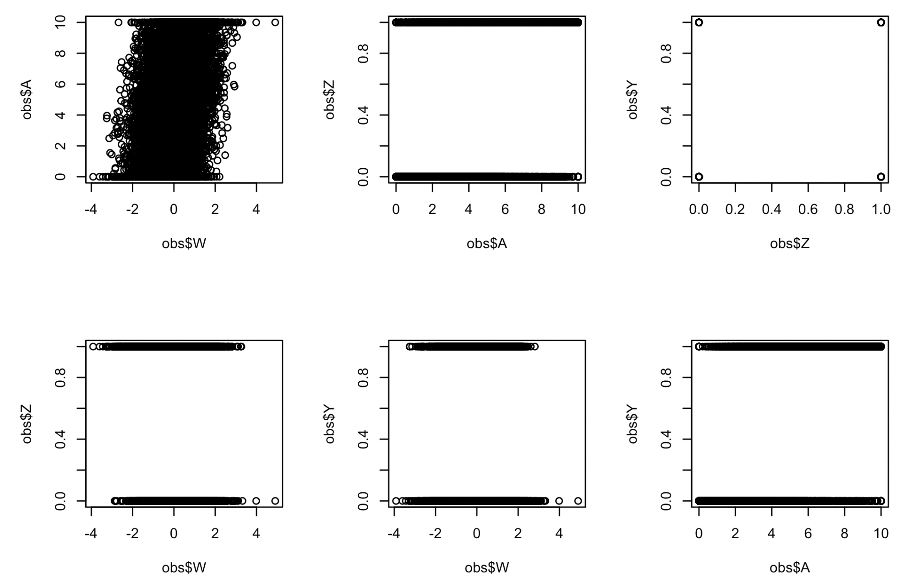
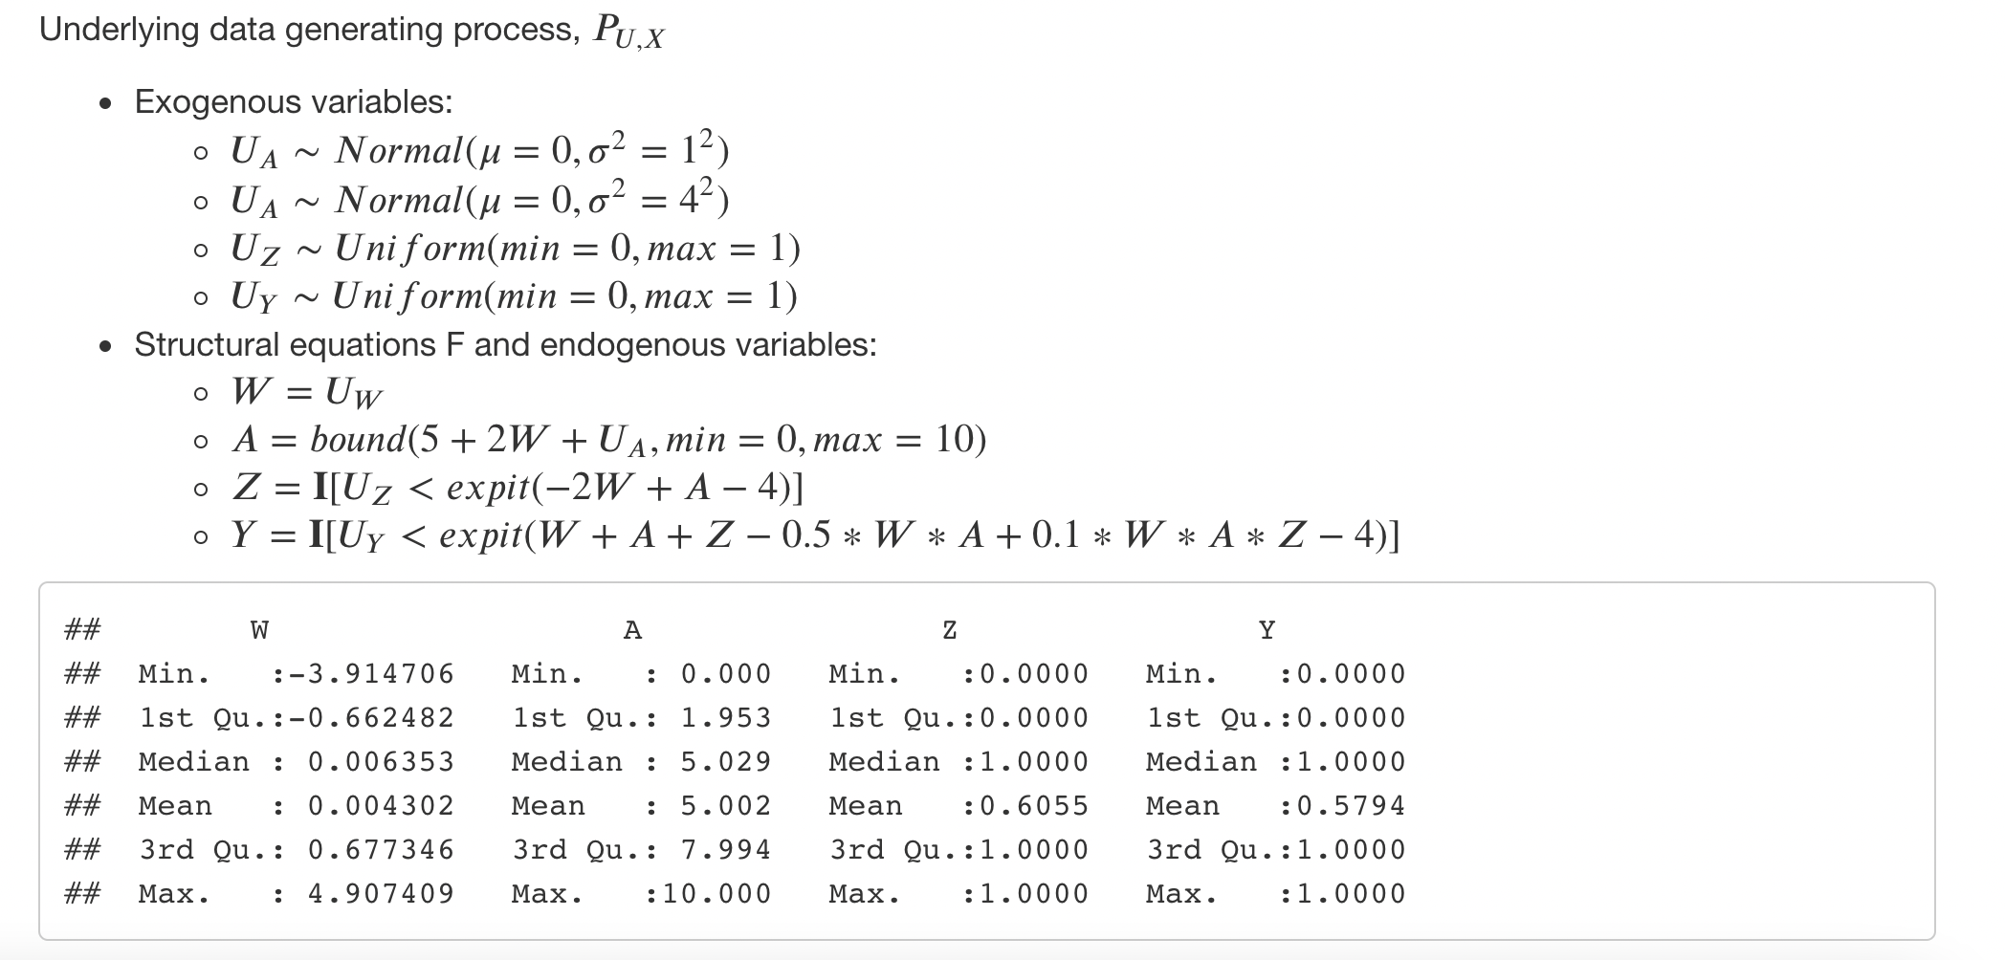
Simulation #2

Slide 16
Simulation #2 – Results summary
n | z | Coverage rate | MSE | Bias | sd
200 | 1
200 | 0
500 | 1
500 | 0
1000 | 1
1000 | 0
z | HAL | Coverage rate | MSE | Bias | sd
1 | under
1 | initial
0 | under
0 | initial
Estimations performed better when z = 1 almost for all a’s

Slide 17
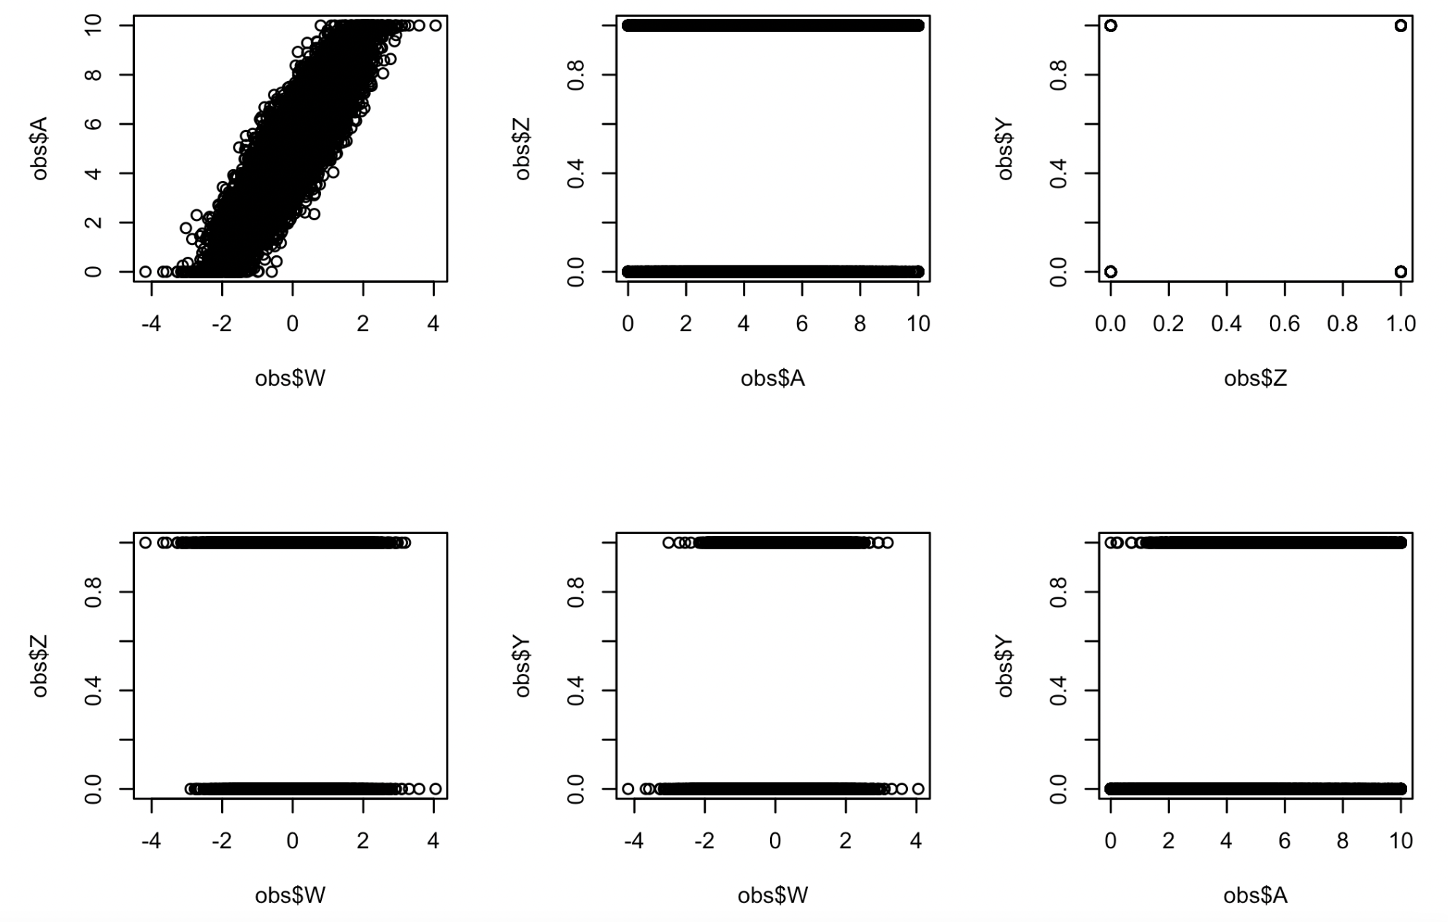
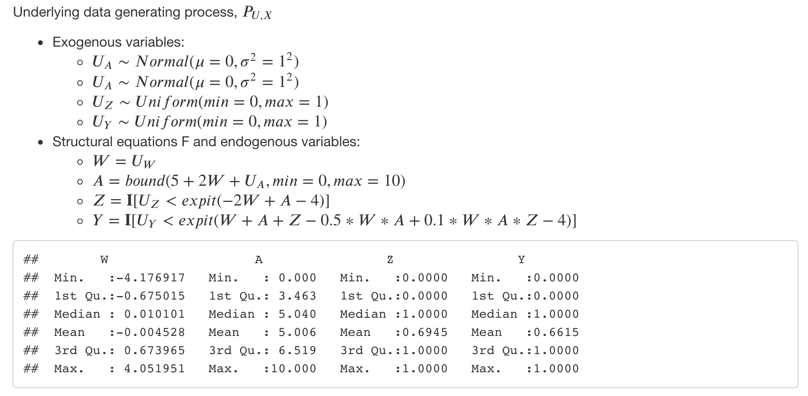
Simulation #3

Slide 18
Simulation #3 – Results summary
n | z | Coverage rate | MSE | Bias | sd
200 | 1
200 | 0
500 | 1
500 | 0
1000 | 1
1000 | 0
z | HAL | Coverage rate | MSE | Bias | sd
1 | under
1 | initial
0 | under
0 | initial
Estimations performed better when z = 1 almost for all a’s

Slide 19
TODO:
Are we over undersmoothing?
Different criteria to choose lambda for undersmoothing?
How to tune undersmoothed HAL to outperform initial HAL in general?
Data adaptively tune he hyperparameters for fitting (undersmoothed) HAL?
How to construct non-oracle CI?
More simulations
Think about DGDs needed to be simulated
Think of a real data example with continuous A and binary Z to do causal inference with under-smoothed HAL.

